Slide 1

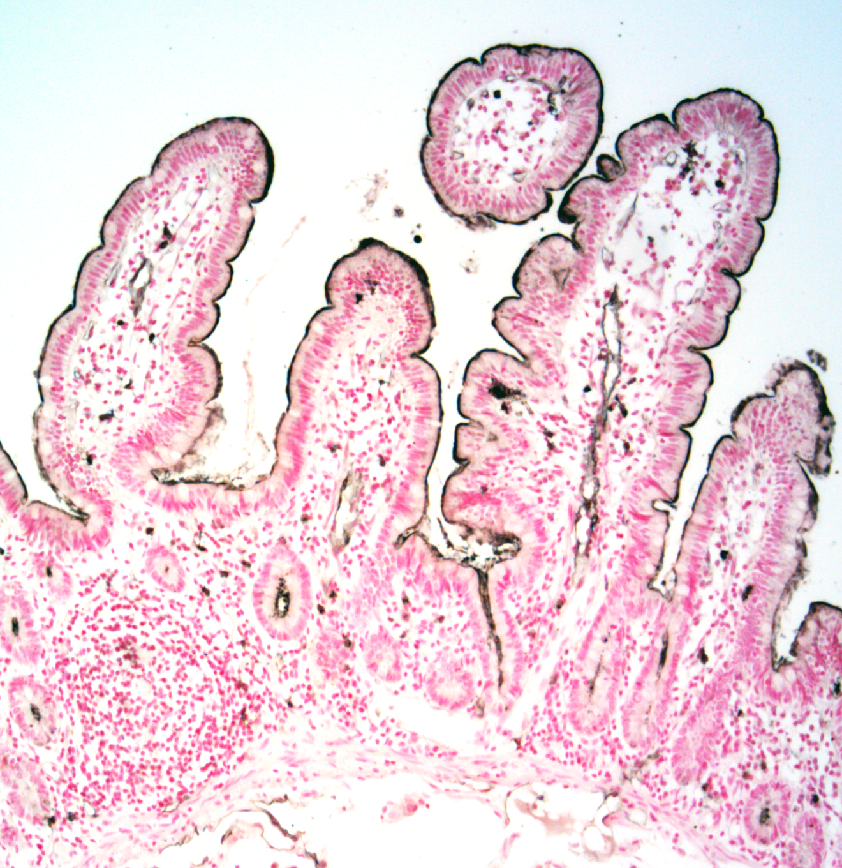
ReliaTech GmbH
Anti-human CEACAM-1 (#C5-1X)
(Cat #101-M81)
Fig. 1: IHC staining of human jejunum tissue with C5-1X. CEACAM1 was detected in PFA-fixed paraffin-embedded sections of human jejunum tissue using mAb C5-1X followed by staining with anti-mouse HRP-DAB and counterstaining with hematoxylin. The labeling showed a clear staining of CEACAM1 by C5-1X.
http://www.reliatech.de / orders@reliatech.de

